Slide 1
ORIENTATION FOR FIRST-YEAR HUMAN RESOURCE COUNSELLING MA STUDENTS
Orientation Day | 2026 Autumn Semester
Széchenyi István University, 02 September 2026

Slide 2
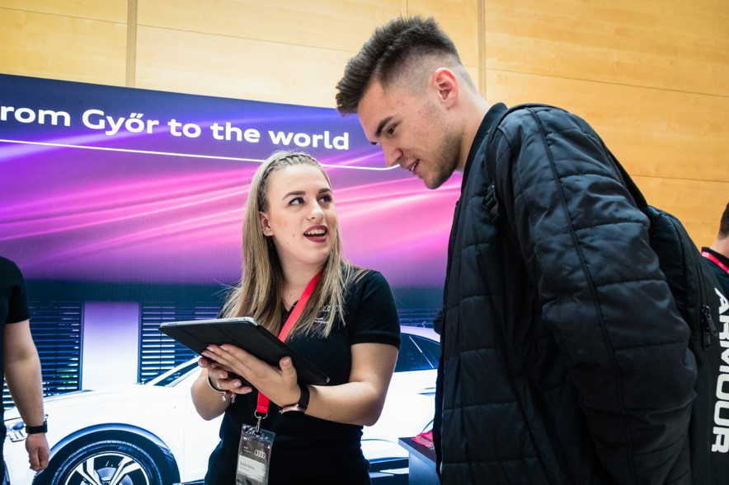
HUMAN RESOURCE COUNSELLING MA PROGRAMME
Diverse human and economic knowledge is combined
Cross-disciplinary approach is developed
Interactive presentations by company professionals and participation in HR conferences and events
4 semesters
120 credits
  110 credits: Compulsory subjects
  10 credits: Elective subjects

Slide 3

APÁCZAI CSERE JÁNOS FACULTY OF HUMANITIES, EDUCATION AND SOCIAL SCIENCES
The programme is organized by Apáczai Csere János Faculty of Humanities, Education and Social Sciences
Apáczai Csere János (1625-1659): Hungarian educator, philosopher, theologian
Outstanding figure of Hungarian education and scientific thought
2025: Apáczai 400 commemorative year

Slide 4
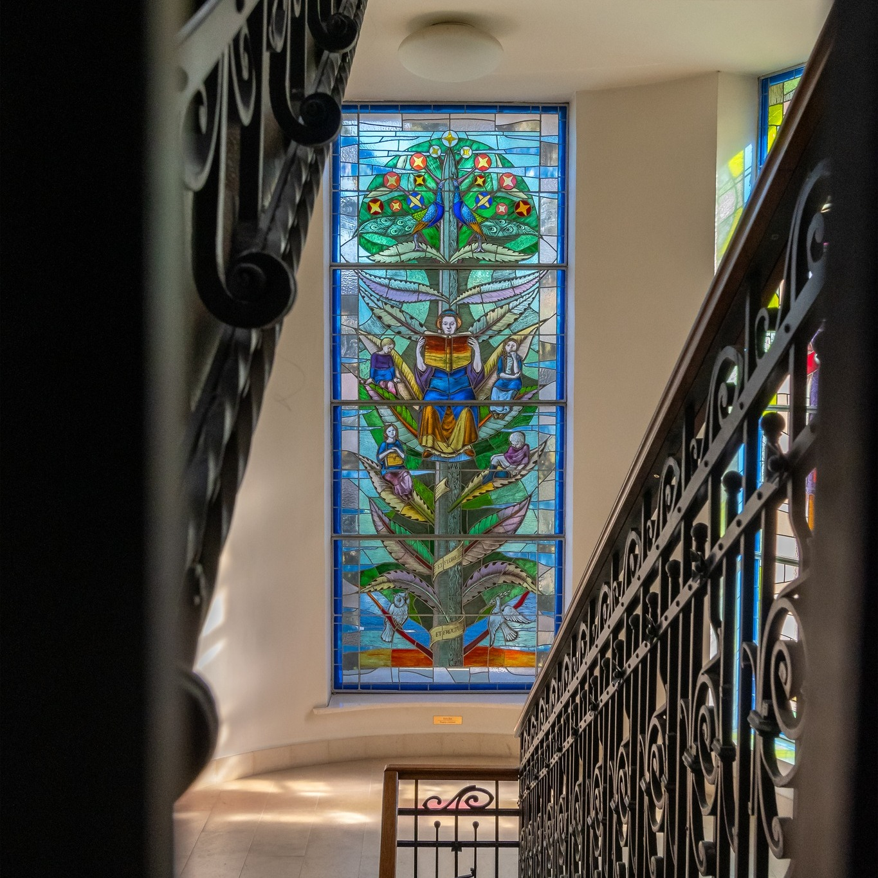
APÁCZAI CSERE JÁNOS FACULTY OF HUMANITIES, EDUCATION AND SOCIAL SCIENCES
Inspired by the past, shaping tomorrow
Nearly 250 years tradition
Professional trainings in Humanities, Education, Social sciences (incl. International Relations BA, Sociology Bsc, Recreation Management and Health Promotion Bsc)
Every programmes are related to supporting people
Welcoming community
Market-relevant and life-oriented knowledge

Slide 5
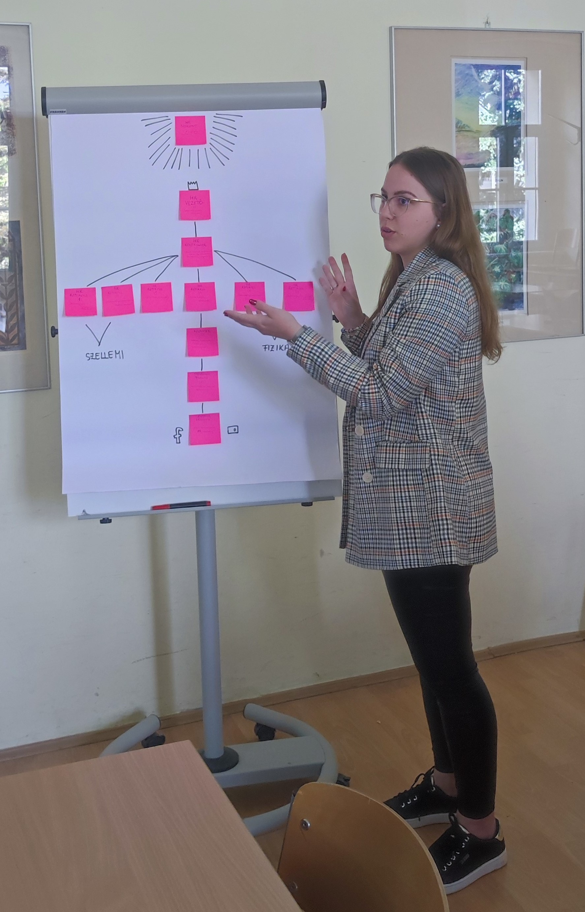
2026 AUTUMN SEMESTER
Courses
  Career Psychology
  Economics of Human Recources
  Labor Market and Employment Policy
  Organizational Consulting Communication
  Theory and Practice of Planning and Consulting I.
  Professional Research Methodology
  Social Psychology at the Workplace
  Special Andragogy
The method of assessment may vary (exam, presentation, term paper etc.)
Completion of the courses shall be determined in consultation with the lecturers

Slide 6
2026 AUTUMN SEMESTER | TIMETABLE
 | MONDAY | TUESDAY | WEDNESDAY | THURSDAY |  | FRIDAY
08:30 – 09:15 | Career Psychology AK1_108 | Professional Research Methodology AK1_111 |  | Hungarian Language and Culture I. AK4_A101
09:25 – 10:10 |  | Professional Research Methodology AK1_111
10:20 – 11:05 | Career Psychology AK1_108 | Organizational Consulting Communication AK1_113 |  | Hungarian Language and Culture I. AK4_A101 | Labor Market and Employment Policy AK1_1413
11:15 – 12:00 |  | Organizational Consulting Communication AK1_113 |  |  | Labor Market and Employment Policy AK1_1413
12:10 – 12:55 | Hungarian Language and Culture I. AK4_A206 | Social Psychology at the Workplace AK4_A308
13:05 – 13:50 |  | Social Psychology at the Workplace AK4_A308
14:00 – 14:45 | Economics of Human Resources AK1_231 | Theory and Practice of Planning and Consulting I. AK1_252 | Hungarian Language and Culture I. AK4_A101
14:50 – 15:35
15:40 – 16:25 | Special Andragogy AK1_1413 | Theory and Practice of Planning and Consulting I. AK1_252
16:30 – 17:15 | Special Andragogy AK1_1413

Slide 7
SCHEDULE FOR THE 2026 AUTUMN SEMESTER
Term time (13 weeks): 07 September 2026 – 05 December 2026
Week of reporting: 07 December 2026 – 12 December 2026
Examination period: 07 December 2026 – 23 January 2026
Semester opening ceremony: 07 September 2026 (Monday) 10:00 AM, University Sports Hall (Main Campus) – NO TEACHING FOR FIRST YEAR STUDENTS, HOWEVER, ATTENDANCE AT THE ACADEMIC YEAR INDUCTION IS MANDATORY
Public holidays (National or religious holidays)
  23 October 2026 (Friday): National Day
  24 December 2026 (Thursday): Chirstmas Eve
  25-26 December 2026 (Friday – Saturday): Christmas
  01 January 2027 (Friday): New Year’s day
Apáczai Scientific Conference: 12-13 November 2026 (Thursday – Friday) – NO TEACHING AT APÁCZAI FACULTY

Slide 8
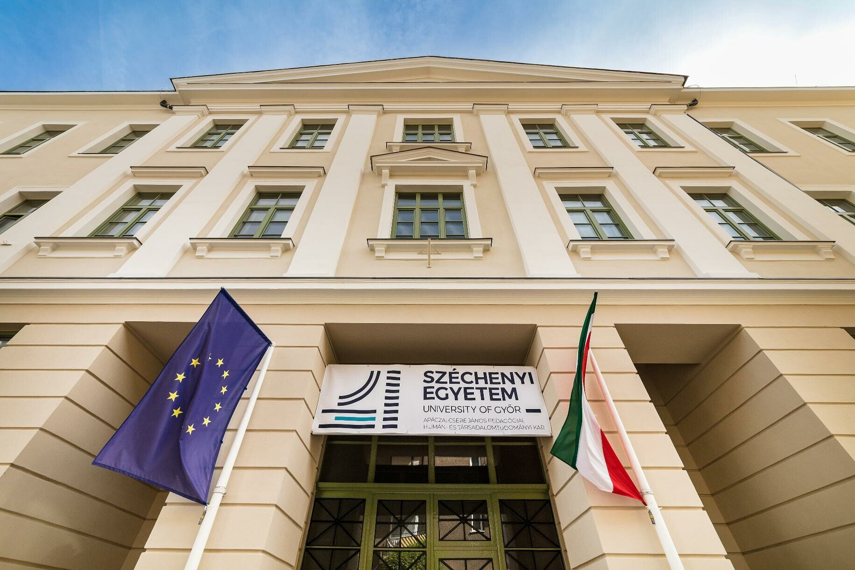
LOCATIONS, BUILDINGS
APÁCZAI FACULTY BUILDING No1 (classrooms marked AK1_xxx)
Main venue of the programme
Address: 9022 Győr, Liszt Ferenc Street 42
Google Maps: „Széchenyi István Egyetem Apáczai Csere János Kar”
GPS coordinates: 47.69000, 17.64094
Located in the historic city center, next to the Árkád Mall
Appr. 15-20 min walking distance from Main Campus

Slide 9
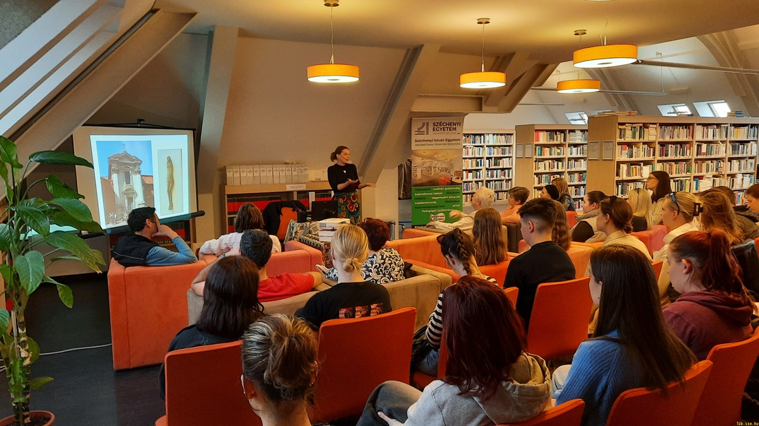
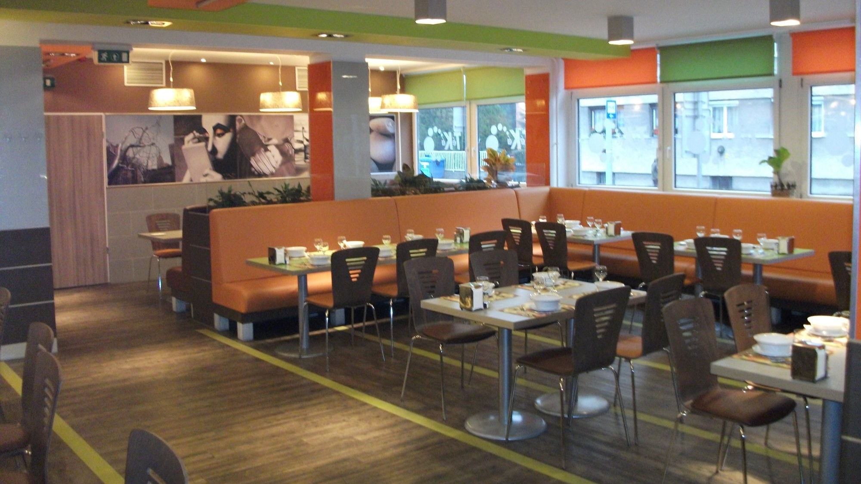
LOCATIONS, BUILDINGS
SERVICES AT APÁCZAI FACULTY BUILDING No1
Apáczai Library
  Pleasant atmosphere, modern environment
  Venue for cultural events, book launches etc.
  Professional assistance for learning and scientific research
Téká Restaurant
  Different types of daily menus
  https://www.facebook.com/tekaetterem
Vending machines: coffee, soft drinks, sweets etc.

Slide 10
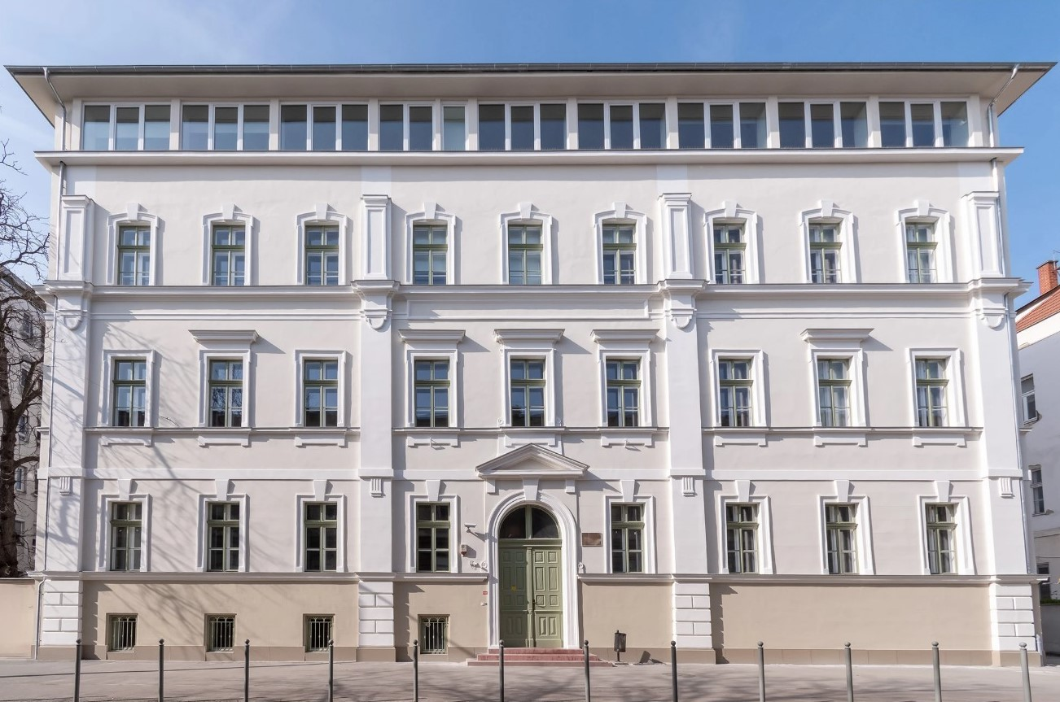
LOCATIONS, BUILDINGS
APÁCZAI FACULTY BUILDING No4 (classrooms marked AK4_xxx)
External venue, location of some classes
Address: 9022 Győr, Gárdonyi Géza Street 10
Google Maps: „Széchenyi István Egyetem Apáczai Csere János Kar IV. számú épület”
GPS coordidantes: 47.68622, 17.64003
Located in the city center
Appr. 4-5 min walking distance from Apáczai Faculty Building No1

Slide 11
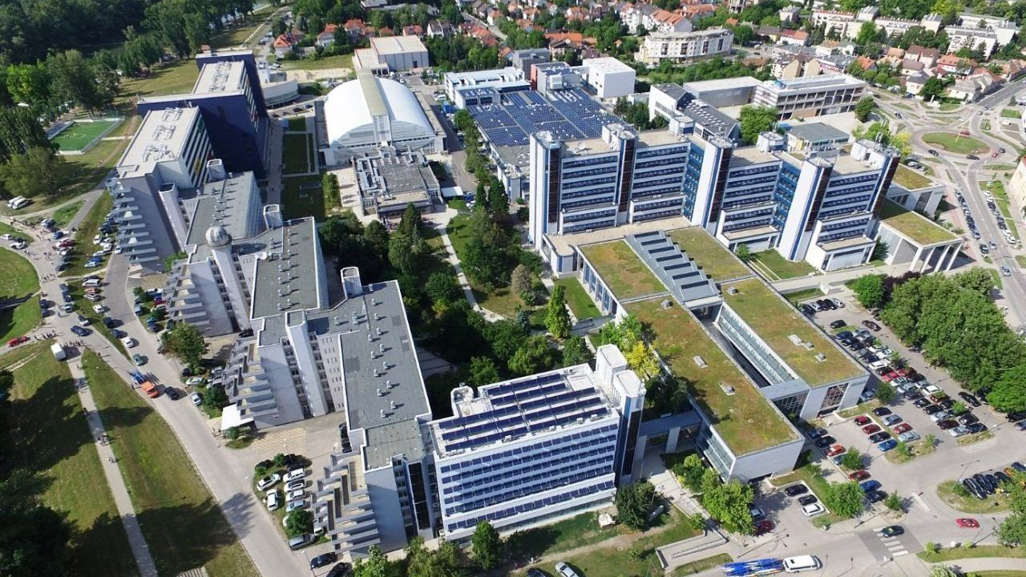
LOCATIONS, BUILDINGS
THE MAIN CAMPUS
Venue for university celebrations and student programmes, location of multiple faculties
Address: 9026 Győr, Egyetem Square 1
Google Maps: „Széchenyi István Egyetem”
GPS coordidantes: 47.69349, 17.62788
Located on the outskirts of the city center, in a green area on the banks of the Mosoni-Danube River.
Appr. 15 min walking distance from historical city center

Slide 12
CONTACTS
PONGRÁCZ, Attila PhD
Dean, Head of Department, Programme Supervisor
Responsible for the contents of the Human Resource Counselling MA programme and management issues
pongracz.attila@sze.hu
RÁKOSI, Szabolcs PhD
Assistant professor, Programme Mentor
Responsible for the academic affairs of students participating in the programme and other issues concerning the stay of international students
rakosi.szabolcs@sze.hu
VAS, Alexandra
Administrative assistant
Responsible for administrative issues related to the programme
Office: AK1_1412
vas.alexandra@sze.hu

Slide 13
THANK YOU FOR YOUR KIND ATTENTION!
PONGRÁCZ, Attila PhD
Dean, Head of Department
Széchenyi István University
Apáczai Csere János Faculty of Humanities, Education and Social Sciences
Department of Humanities and Human Resources
pongracz.attila@sze.hu
RÁKOSI, Szabolcs PhD
Assistant professor
Széchenyi István University
Apáczai Csere János Faculty of Humanities, Education and Social Sciences
Department of Humanities and Human Resources
rakosi.szabolcs@sze.hu

